Slide 1

Bird
Samir Hauser, Connor Charlton, Joel Alder

Slide 2

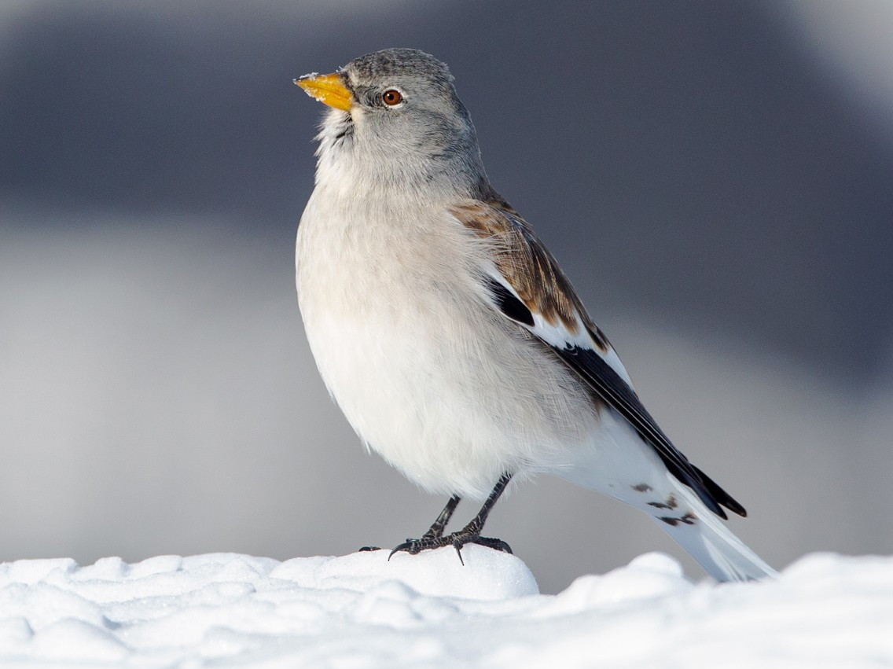
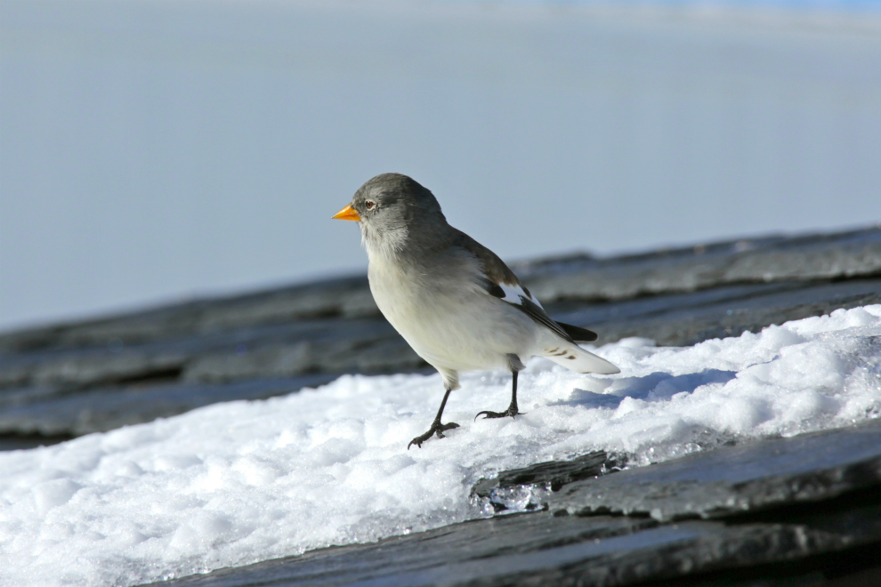
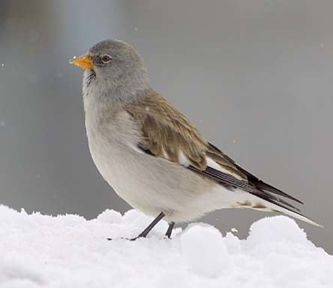
Snow-finches

Slide 3
Background
Can’t visually sex the bird
Survival chance of snow-finches depends on their sex
Capture the birds and measure morphological traits (weight, feather length, etc.)
Researcher determine the sex via a gene test
Main Goal: Possibility to determine the sex via the morphological traits

Slide 4
Research Question
Develop a model that gives the probability for the sex via the morphological traits
Identify which measurements are important, that they know which one possibily to drop
Develop a model for the adult birds and one for the nestlings

Slide 5
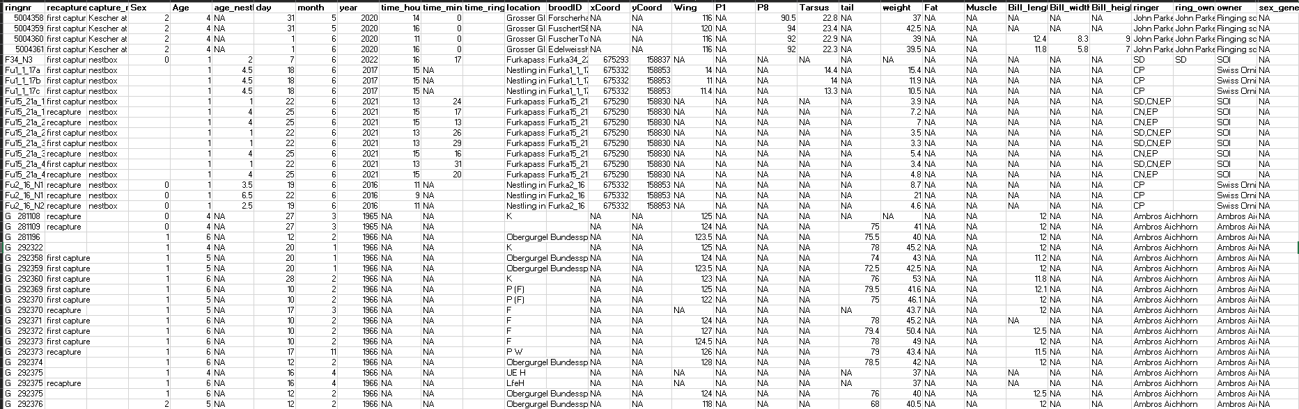
Overview of Data

Slide 6
Data
Variable | Description
Age | 1 = nestling , >1 : adult bird
Wing | length in mm
P1 / P8 | feather length
Tarsus | leg length
Weight | in g (strongly varies with time of year)
Fat | (0 = lean, 6 = fat)
Muscle | (0 = hardly any muscle, 3 = a lot of muscle)
Bill length | In mm
Sex | Sex guess of the person who collected it
Ringer | Person which collected the data
Location | Place where the birds were collected
Time | When the data was collected
Sex_genetic | Sex determined via gene test
Sample size:
Total: 2’287
Nestling: 706

Slide 7
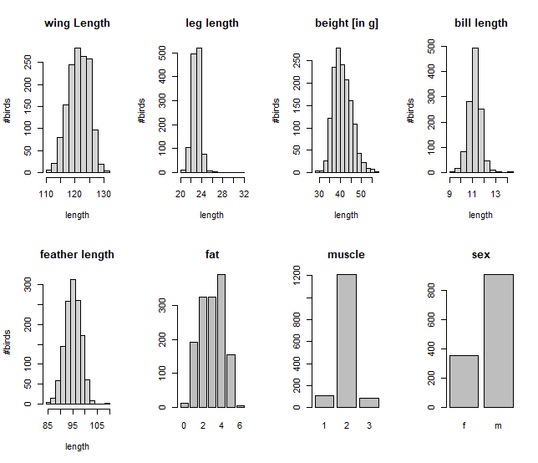
Adult bird data
1561 adult observations
Variable | NaN | % of total
Wing | 135 | 6.5%
Tarsus | 349 | 22.4%
Bill length | 375 | 24.0%
Feather length | 267 | 17.1%
Weight | 92 | 5.9%
Fat | 160 | 10.3%
Muscle | 158 | 10.1%
Sex (genetics) | 298 | 19.1%

Slide 8
Crosstable of adult brid data
Only adult bird data:
5 locations cover approx. 84% of all observations.
Age category 4 is the most frequent.
Age and sex frequency is largely identical across the observed locations.
Corviglia deviates slightly from this.
 |  |  | AGE
 |  |  | 2 | 4 | 5 | 6
LOCATION | Arosa | female | 0% | 27% | 3% | 0% | 31%
 |  | male | 0% | 52% | 9% | 8% | 69%
 |  |  | 0% | 80% | 13% | 8% | 100%
 | Corviglia | female | 4% | 16% | 2% | 1% | 22%
 |  | male | 18% | 56% | 0% | 4% | 78%
 |  |  | 22% | 72% | 2% | 5% | 100%
 | Distelboden | female | 3% | 27% | 4% | 0% | 35%
 |  | male | 5% | 51% | 4% | 5% | 65%
 |  |  | 8% | 78% | 8% | 5% | 100%
 | Nante | female | 1% | 31% | 0% | 0% | 32%
 |  | male | 5% | 63% | 0% | 0% | 68%
 |  |  | 6% | 94% | 0% | 0% | 100%
 | Tiefenbach | female | 0% | 25% | 1% | 1% | 27%
 |  | male | 3% | 64% | 0% | 6% | 73%
 |  |  | 3% | 89% | 1% | 7% | 100%

Slide 9
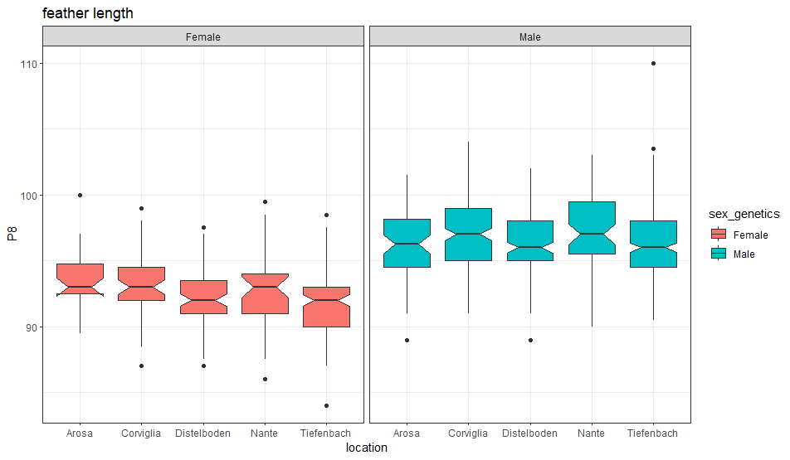
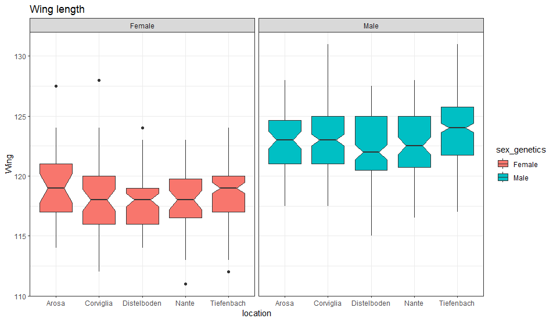
A first glance Promising Variables I covariates
 |  | AGE
 |  | 2 | 4 | 5 | 6
Location | Arosa | 0% | 80% | 13% | 8%
 | Corviglia | 22% | 72% | 2% | 5%
 | Distelboden | 8% | 78% | 8% | 5%
 | Nante | 6% | 94% | 0% | 0%
 | Tiefenbach | 3% | 89% | 1% | 7%
Feather length
Wing length

Slide 10
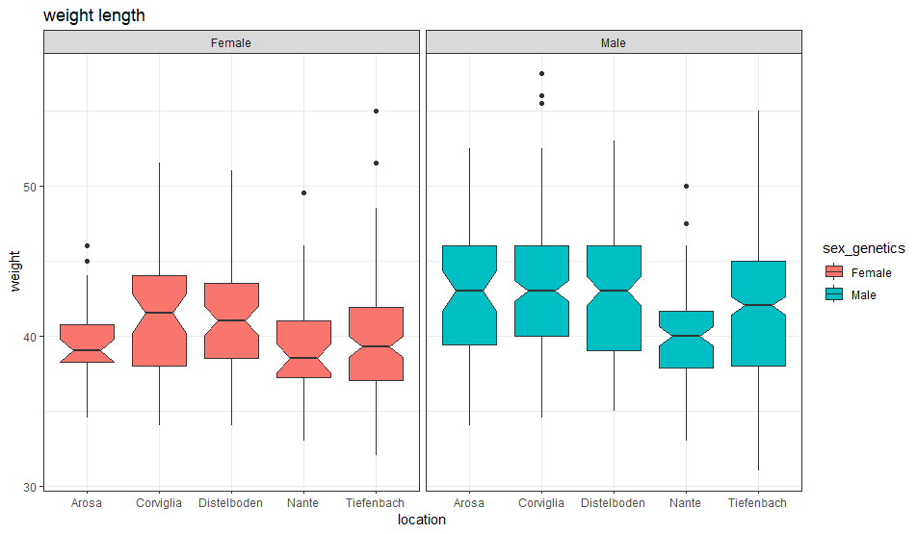
A first glance Promising Variables II covariates
 |  | AGE
 |  | 2 | 4 | 5 | 6
Location | Arosa | 0% | 80% | 13% | 8%
 | Corviglia | 22% | 72% | 2% | 5%
 | Distelboden | 8% | 78% | 8% | 5%
 | Nante | 6% | 94% | 0% | 0%
 | Tiefenbach | 3% | 89% | 1% | 7%
Morphological traits such as:
Feather length, Wingth length and Weight might be different between male and female brids.
Weight

Slide 11
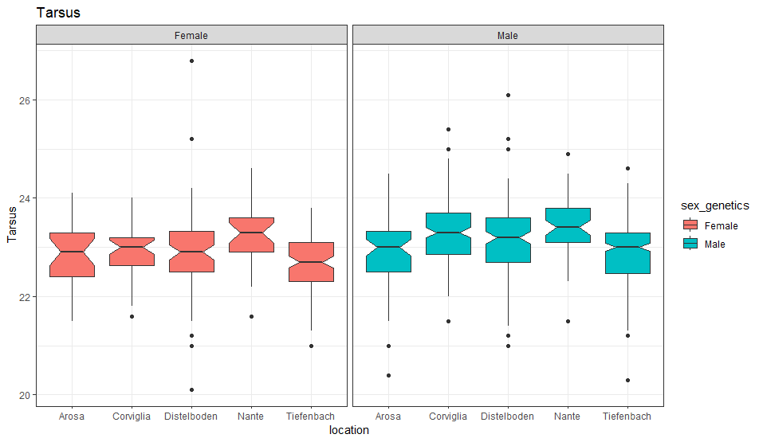
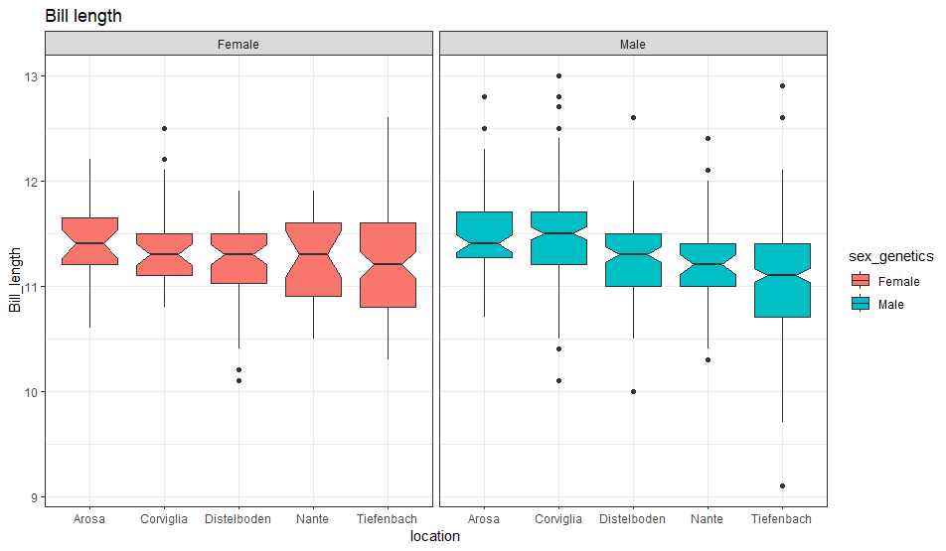
A first glance Promising Variables III covariates
 |  | AGE
 |  | 2 | 4 | 5 | 6
Location | Arosa | 0% | 80% | 13% | 8%
 | Corviglia | 22% | 72% | 2% | 5%
 | Distelboden | 8% | 78% | 8% | 5%
 | Nante | 6% | 94% | 0% | 0%
 | Tiefenbach | 3% | 89% | 1% | 7%
Tarsus
Bill length

Slide 12
How good is an educated guess?
It was guessed (by eye) whether a bird is male or female in 415 observations.
A correct classification was achieved in 93.2% of these observations.
Where are the mistakes?

Slide 13
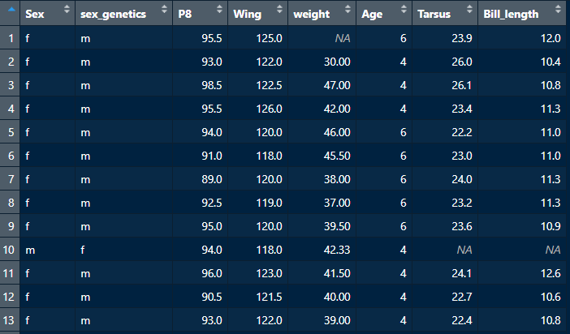
How good is an educated guess?
It was guessed (by eye) whether a bird is male or female in 415 observations.
A correct classification was achieved in 93.2% of these observations.
Where are the mistakes?
Feather length
Wing length

Slide 14
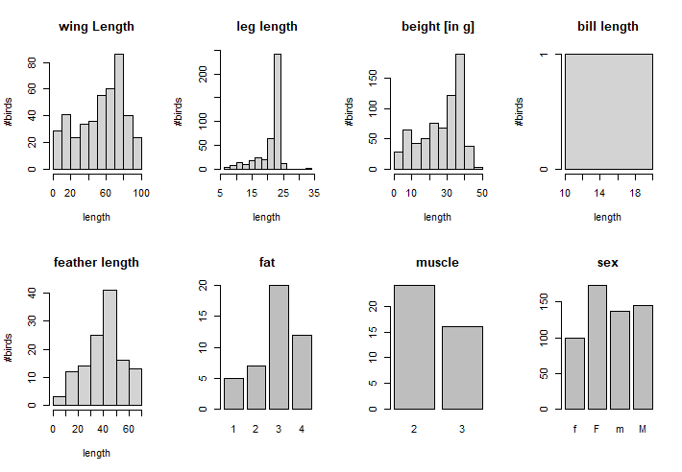
Nestling bird data
706 nestling observations
Variable | NaN | % of total
Wing | 277 | 39.2%
Tarsus | 280 | 39.7%
Bill length | 705 | 99.8%
feather length | 582 | 82.4%
weight | 23 | 3.3%
Fat | 662 | 93.8%
Muscle | 158 | 94.3%
sex_genetics | 152 | 21.5%

Slide 15
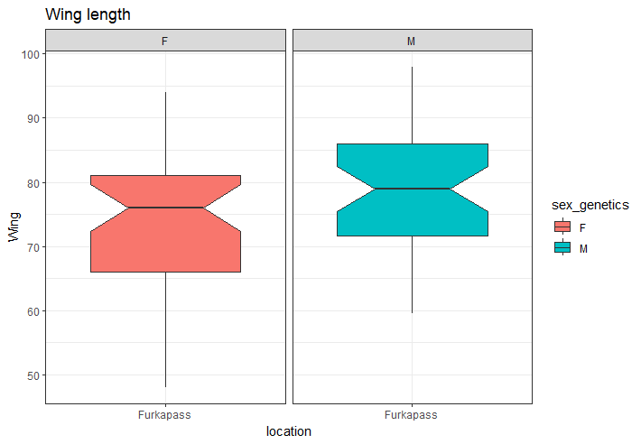
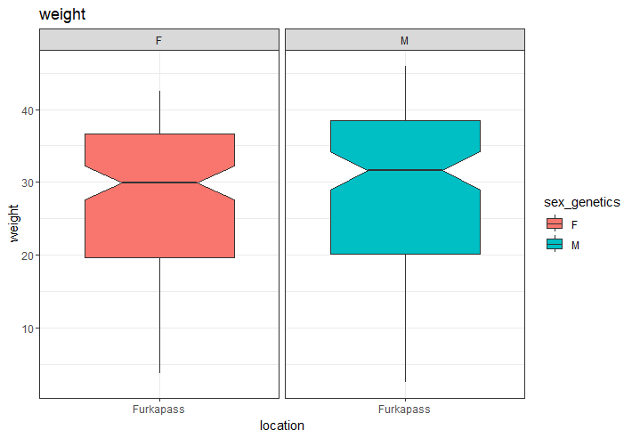
A first glance on Nestling data I

Slide 16
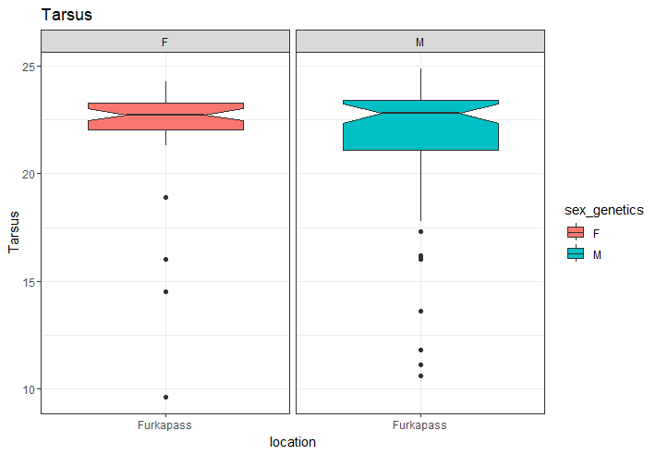
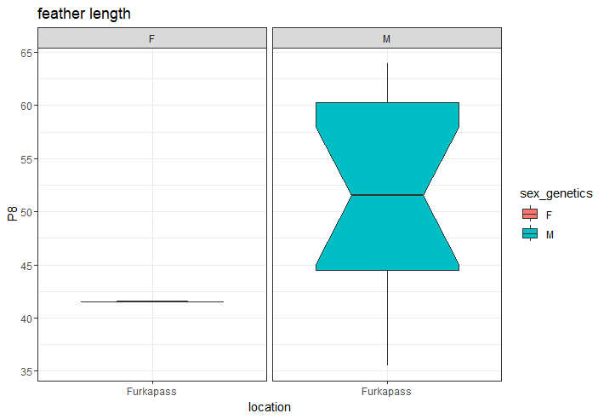
A first glance on Nestling data II IIvariates

Slide 17
Estimating the missing values
Treat NA as a value in itself (i.e. make it a factor level)
Impute missing values by use of a clustering based imputation method
Impute missing values using multiple imputation by chained equations (MICE)

Slide 18
Two Main question
How to fill out the missing values
For nearly every bird one measurement is missing
First idea: Regression
Should we include other data than the morphological traits?
Like the guessing of the sex, the ringer, location, time
Client is interested in a model which contains only the morphological traits

Slide 19
Approach
Missing Data
Regression to fill up the missing values
Supervised learning method to determine sex
Seperate models for adult and nestlings
Classification
Logistic Regression
Trees & Random Forest

Slide 20
Overview of the data for the different time

Slide 21
First resutls of a logistic model

